Slide 1
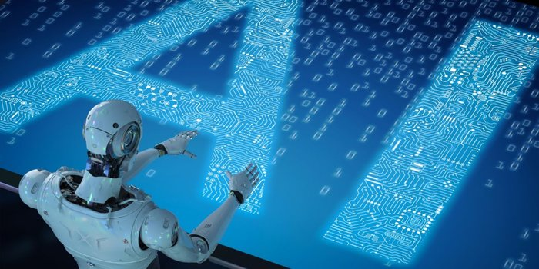
Artificial Intelligence An Ocean of Opportunity

Slide 2
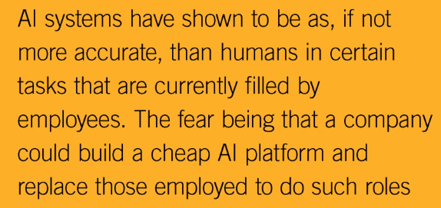
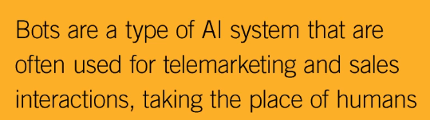
Introduction to Artificial Intelligence
Artificial Intelligence and Machine Learning is a transformative technology that is headlining in the press all the time.
On one side, AI is viewed as all ‘Robots or Bots' and that everyone in the country is worried about their job being displaced by a machine. (There are projections by the World Economic Forum of 5 million jobs being lost. Clerical is being targeted as one of the primary sectors, and finance, law are others that are being targeted as well.)
On another side, AI is viewed as ‘Augmentation of the human'. So not just artificial intelligence alone, not just the human alone, but the marriage of the two, and having more the emergent properties being more than either of them.
Augmented Reality or Mixed Reality is the Overlaying of Intelligence onto our physical world added with Artificial Intelligence and Machine Learning Algorithms could provide some great insights or capabilities in many contexts.

Slide 3
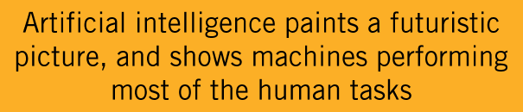
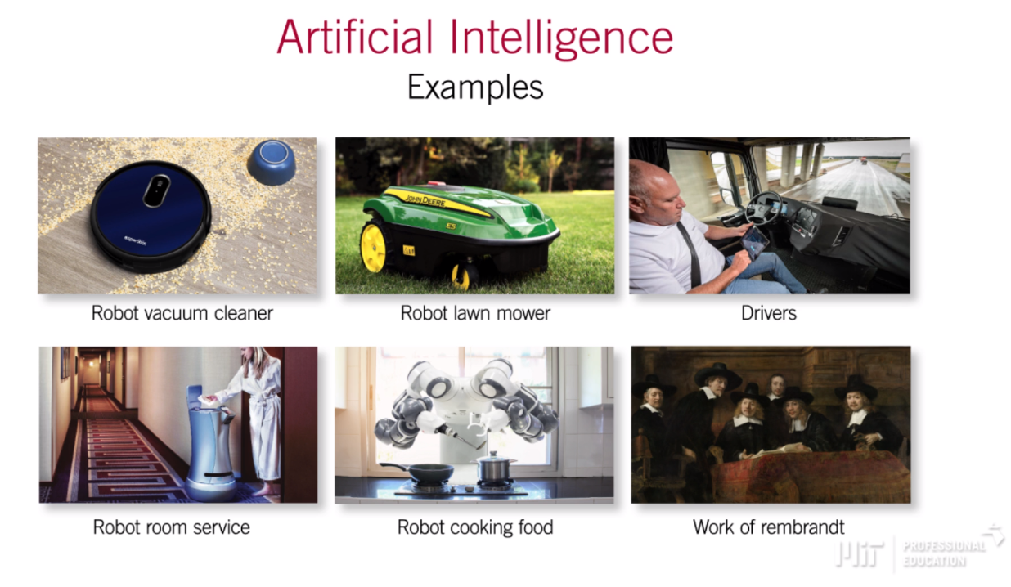
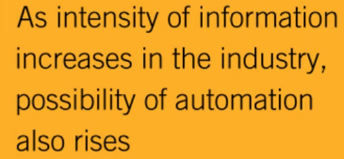
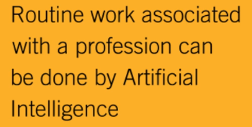
Artificial Intelligence – (Automation) Machines outperforming humans

Slide 4
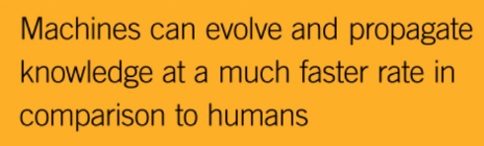
Artificial Intelligence – Machine Evolution (Vs Humans)
Human Evolution
If a human makes a mistake and learns how to correct it, that human has learned and corrected that mistake;
However, how long will it take before the world can learn what that one human has learned?
Machine Evolution
When a computer learns something, the propagation of this knowledge is instantaneous;
Not only that, every new machine that is born already has this knowledge.

Slide 5

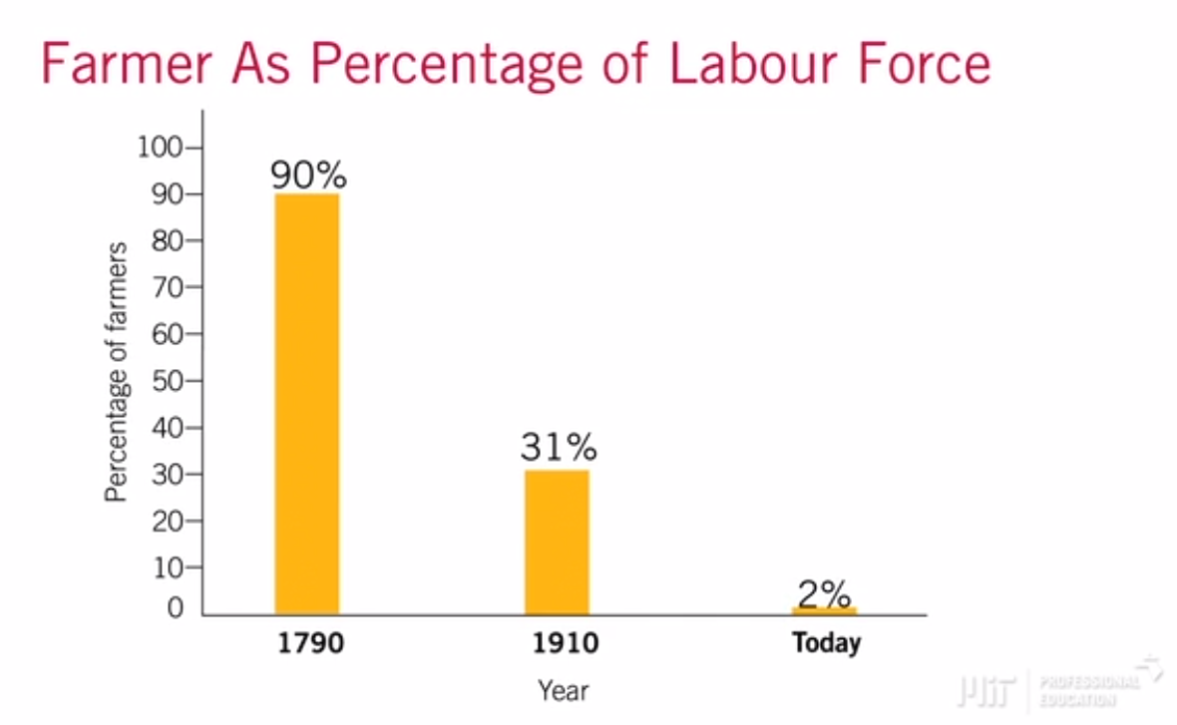
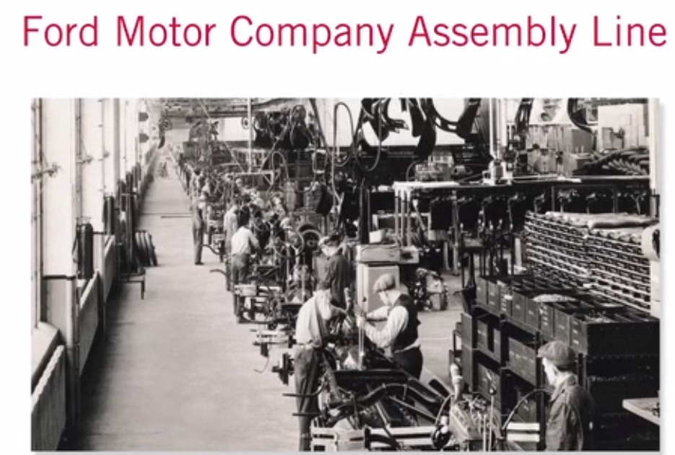
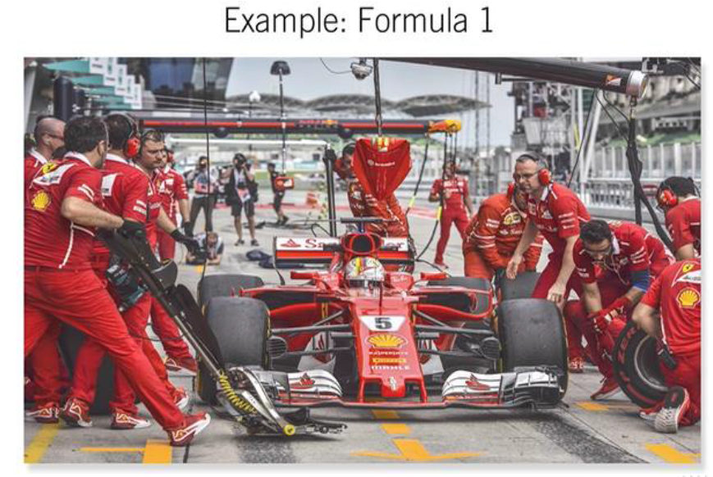
Artificial Intelligence – (Beyond Automation) Disruption in Industries
Repetitive, Routine and Optimized Processes
Flexible Processes (AI & IOT)
Highly Repetitive & Arduous Processes
Highly Fixed & Optimized Processes
Transformative
Processes

Slide 6
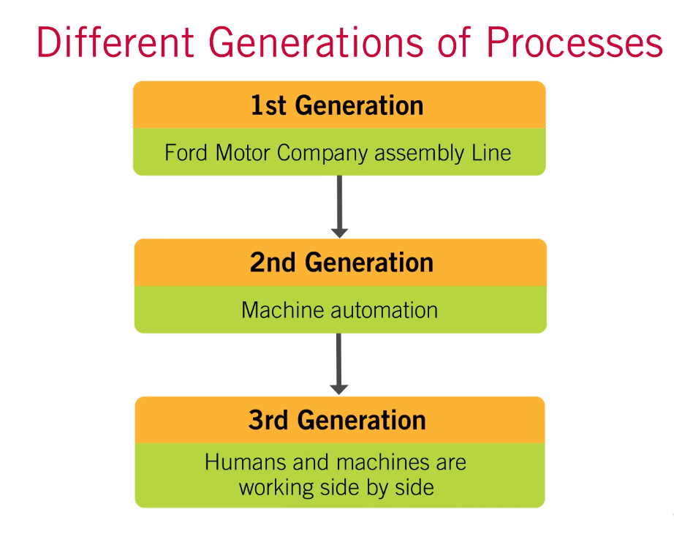
Artificial Intelligence – (Beyond Automation) Disruption in Industries
Ford Company with its Model T and it's assembly line was the prime example of this generation;
Very routine and very repetitive processes;
Machines and Software matured replacing humans;
Automation of very fixed/hard to change processes on the factory floor;
More flexible and Agile processes with added intelligence;
Digital transformation & Artificial Intelligence systems, born for a more agile type of organization.

Slide 7
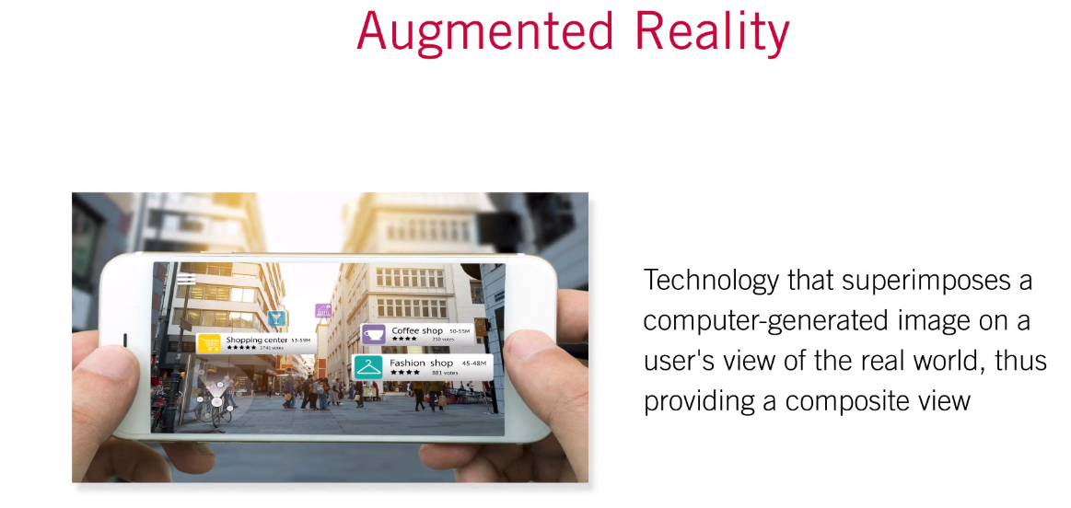
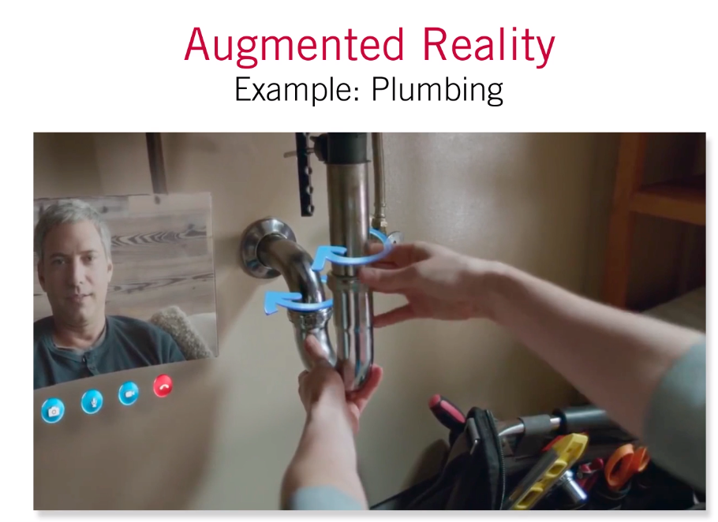
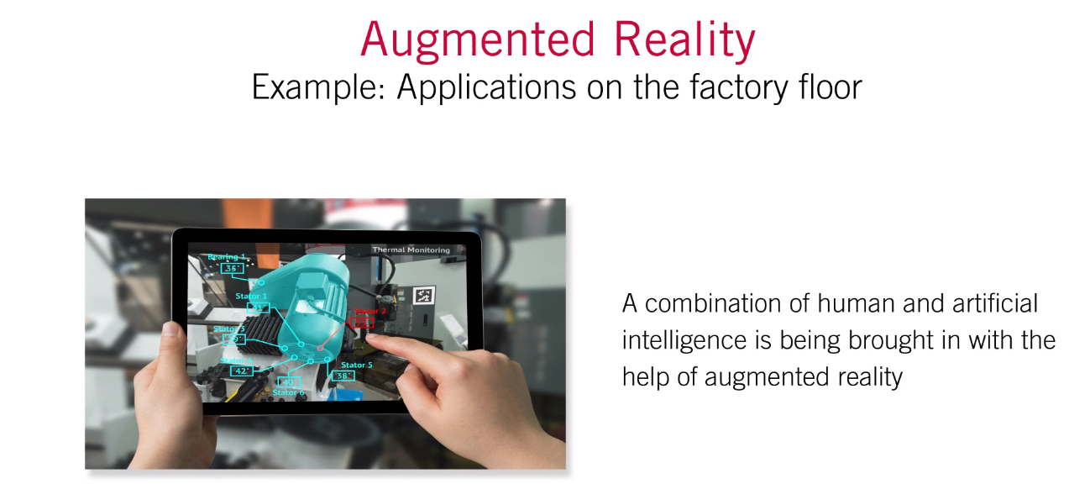
Artificial Intelligence – (Beyond Automation) Disruption in Industries

Slide 8
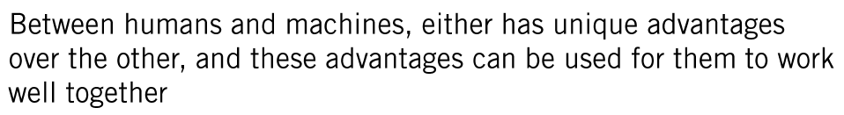
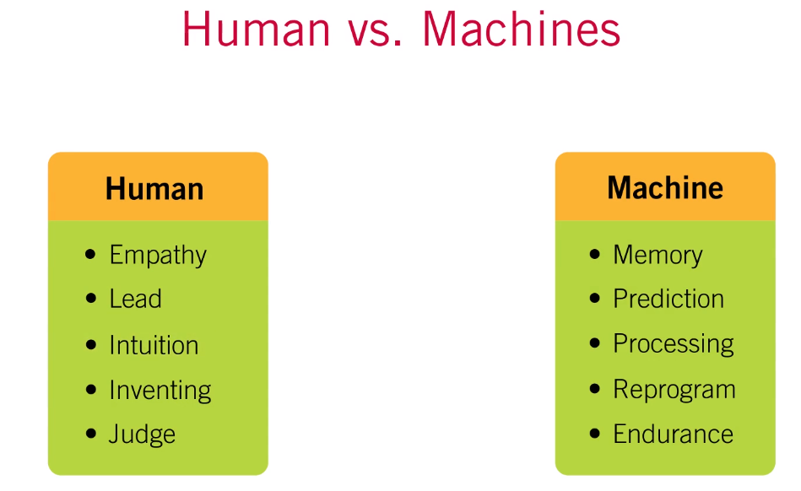
Artificial Intelligence – (Beyond Automation) Disruption in Industries

Slide 9
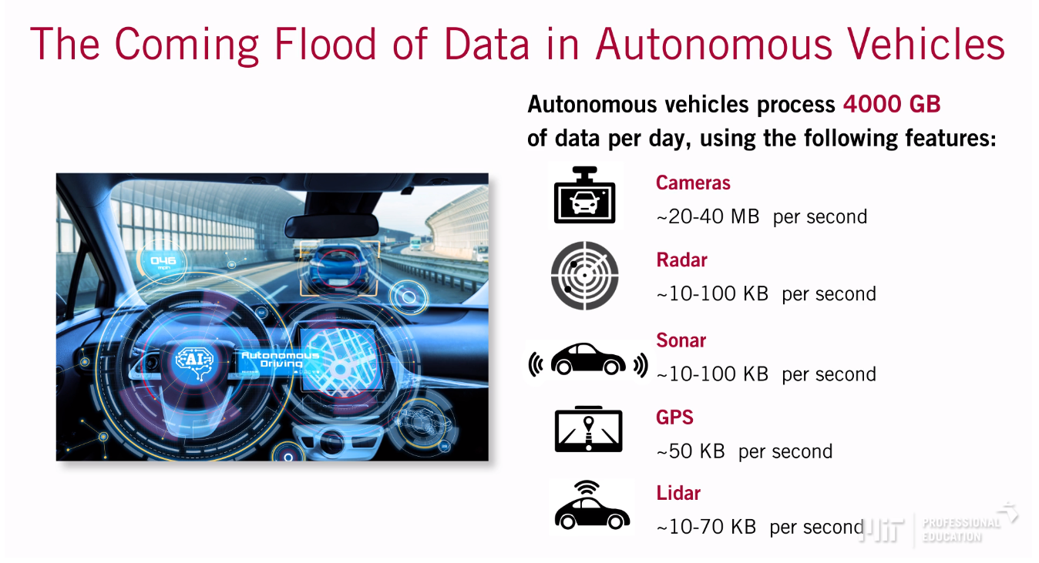
Artificial Intelligence – Managing Data with AI and Machine Learning

Slide 10
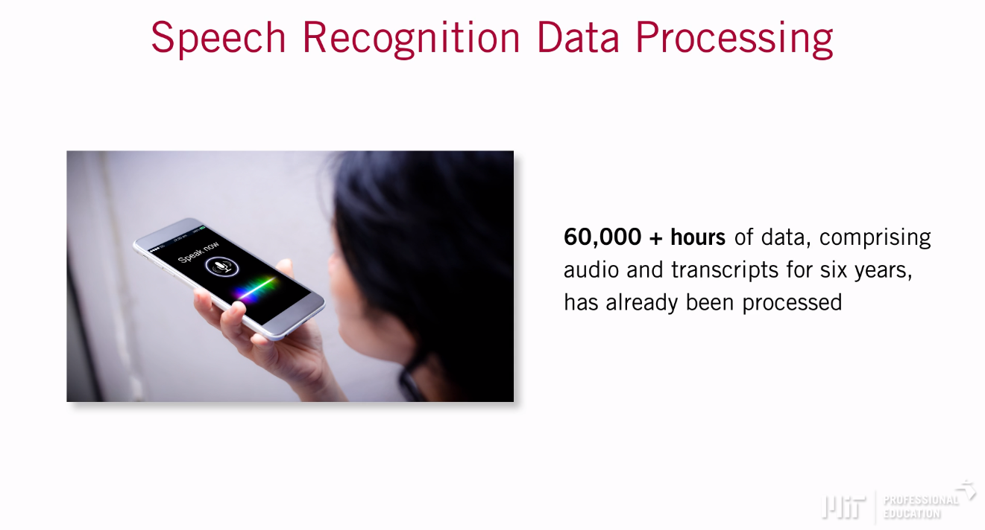
Artificial Intelligence – Managing Data with AI and Machine Learning

Slide 11
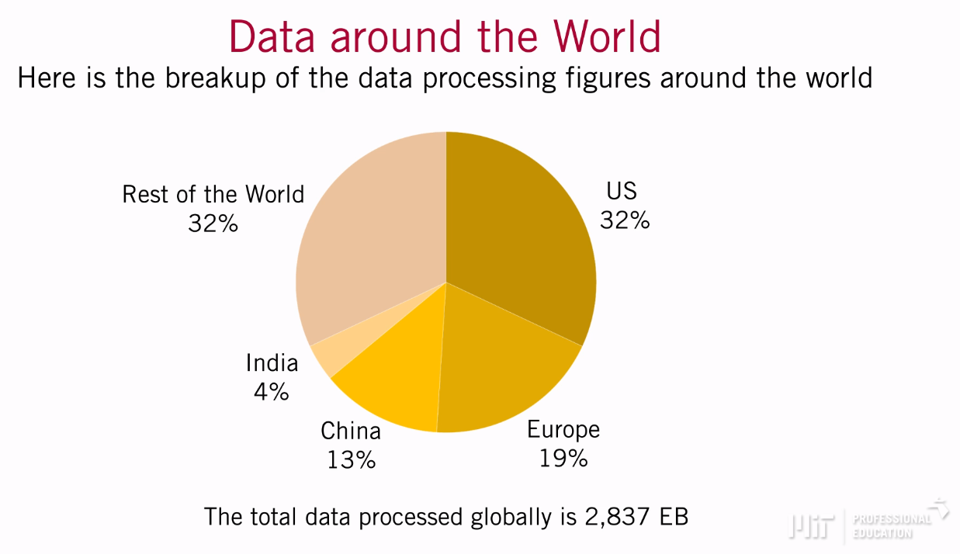
Artificial Intelligence – Managing Data with AI and Machine Learning

Slide 12
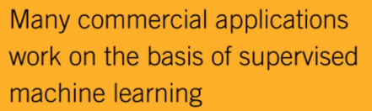
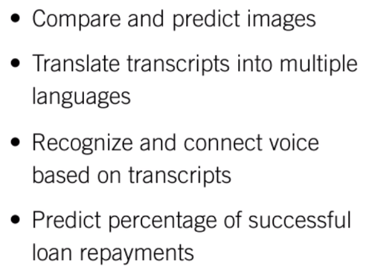
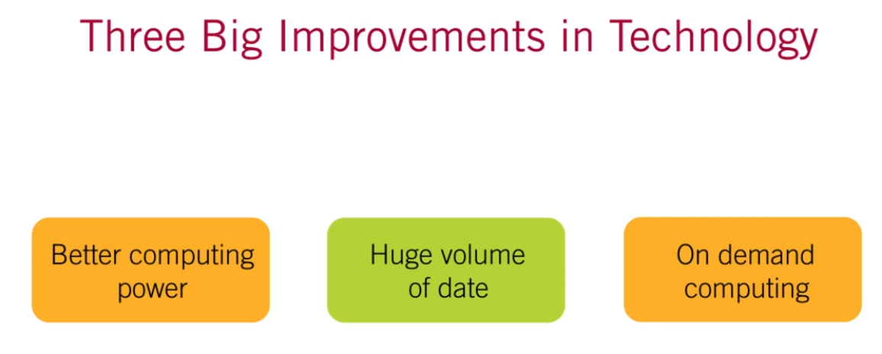
Artificial Intelligence – State of the Practice

Slide 13
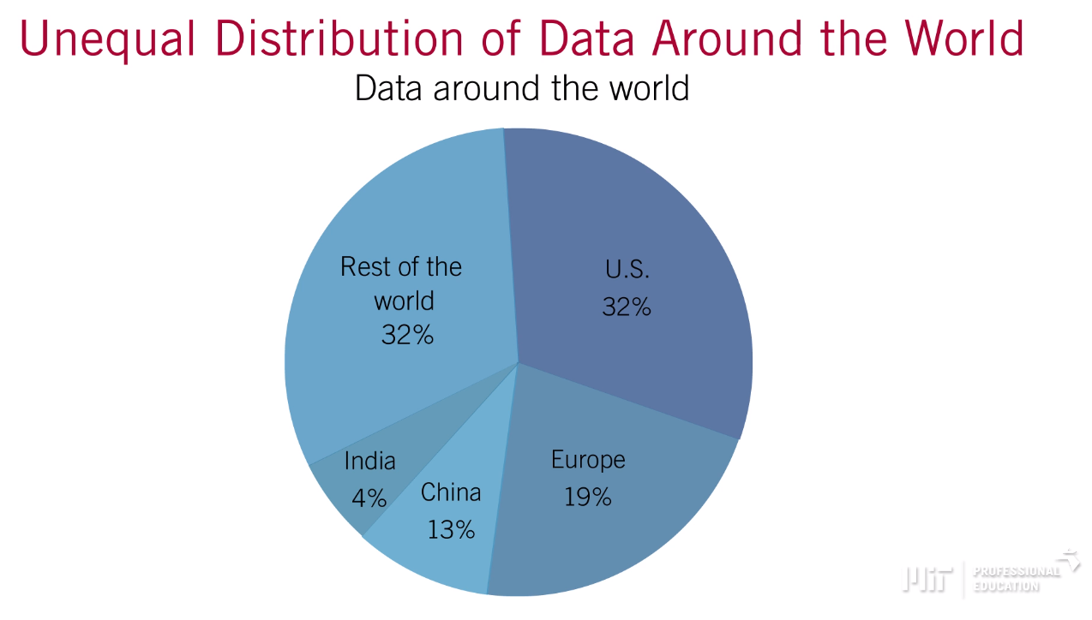
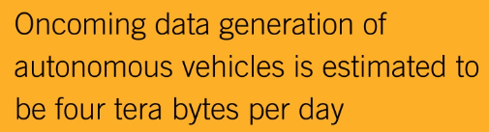
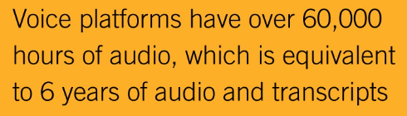
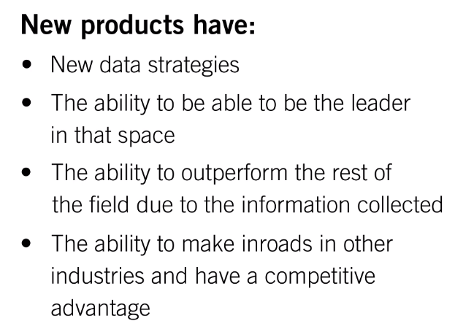
Artificial Intelligence – Building Capabilities: Data and Data Science Team
Barrier to Compete – Data

Slide 14
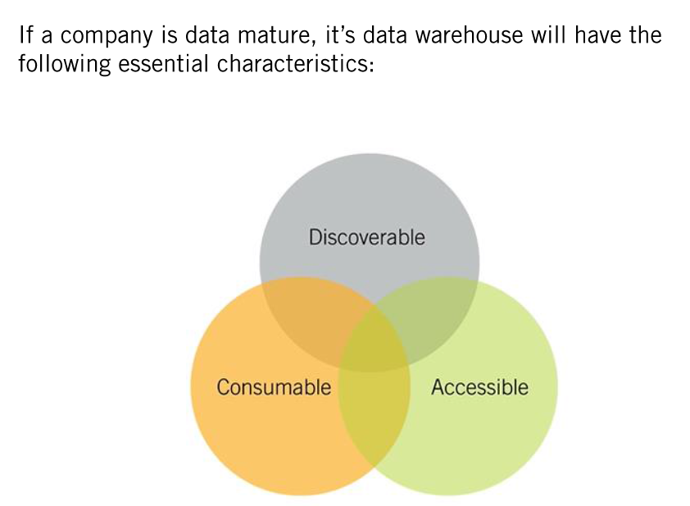
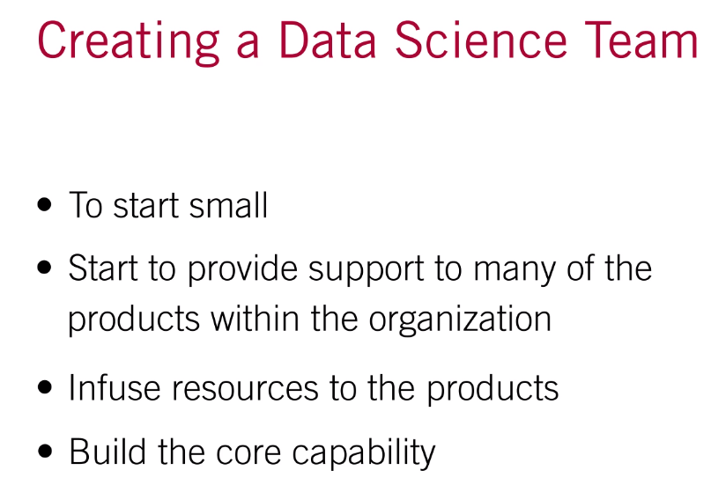
Artificial Intelligence – Building Capabilities: Data and Data Science Team

Slide 15
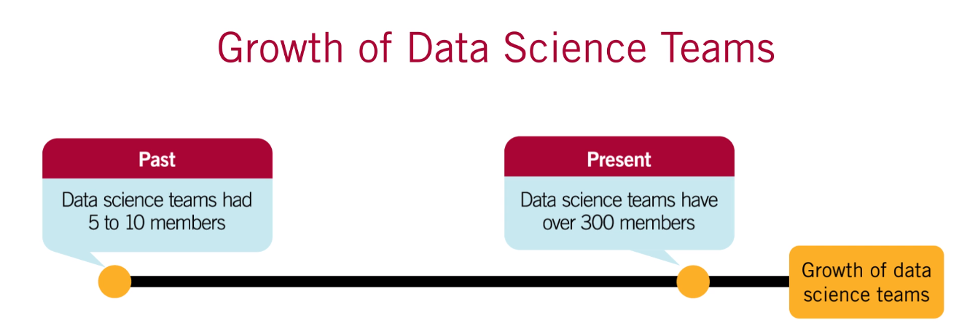
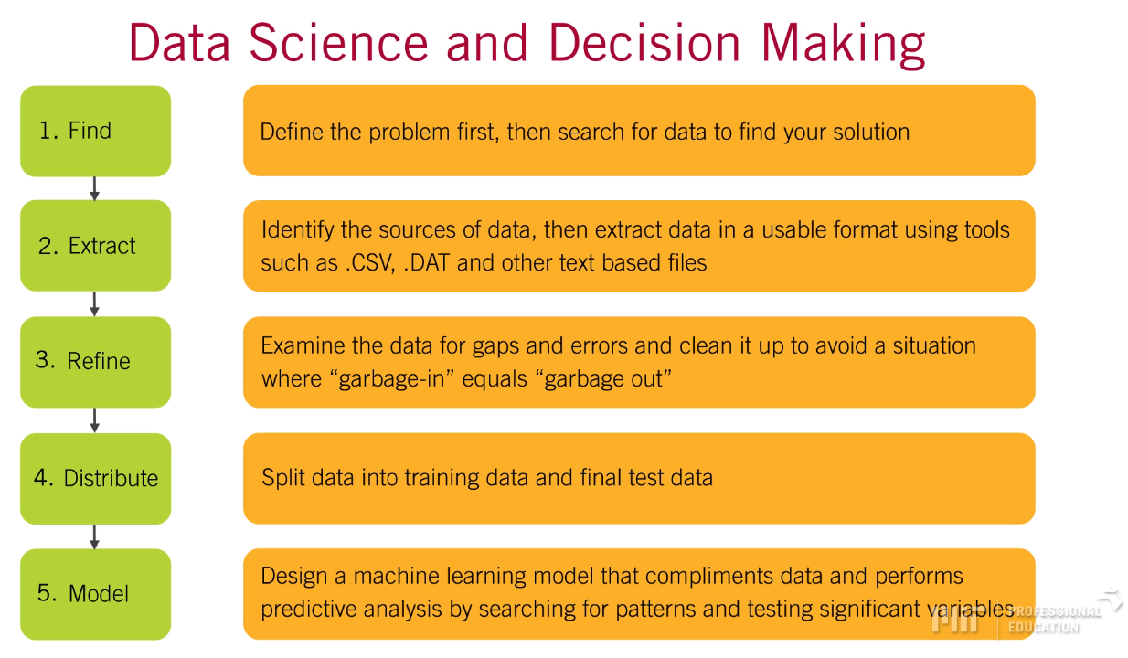
Artificial Intelligence – Building Capabilities: Data and Data Science Team

Slide 16
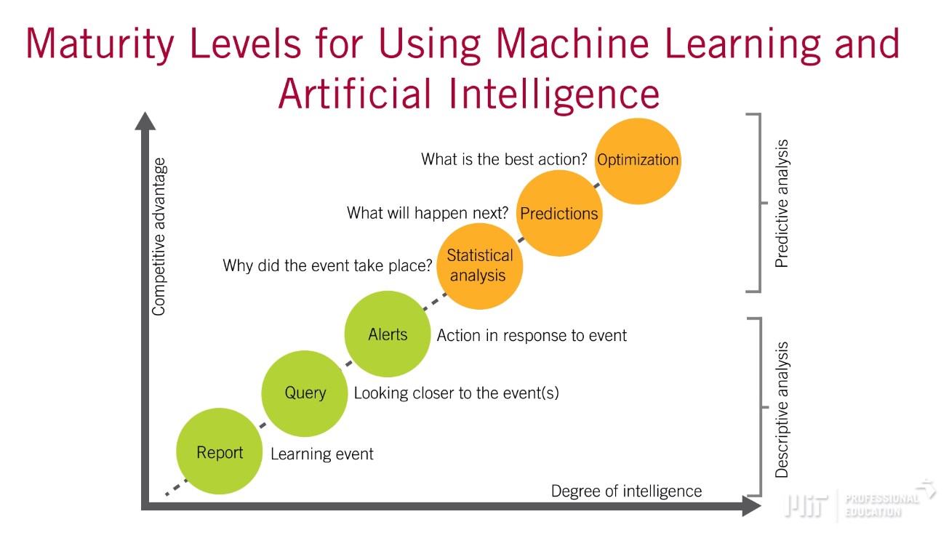
Artificial Intelligence – Building Capabilities: Data and Data Science Team

Slide 17
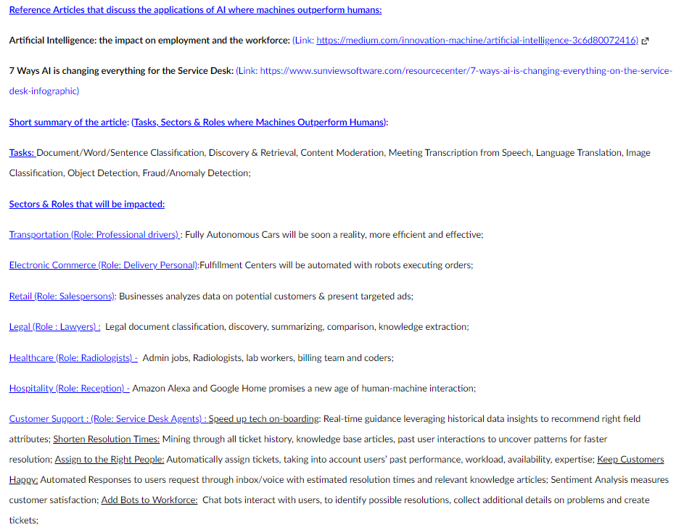
Summary: AI Displacing Humans in the Workforce
Applications of AI where Machines outperform or are expected to outperform Humans

Slide 18
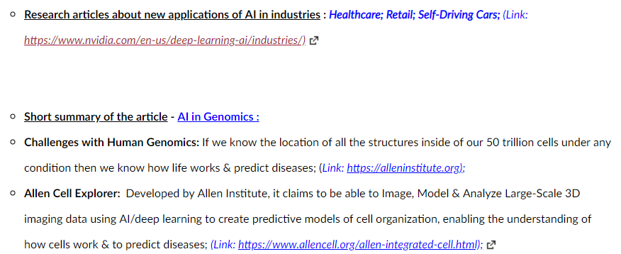
Summary: Industries Being Newly Affected by AI
New Applications of AI in industries that have traditionally not been sources for AI adoption

Slide 19
Demo
v0

Slide 20
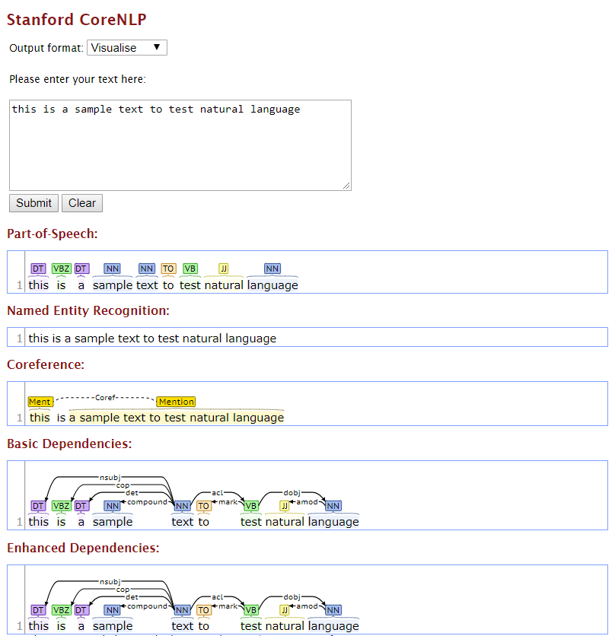
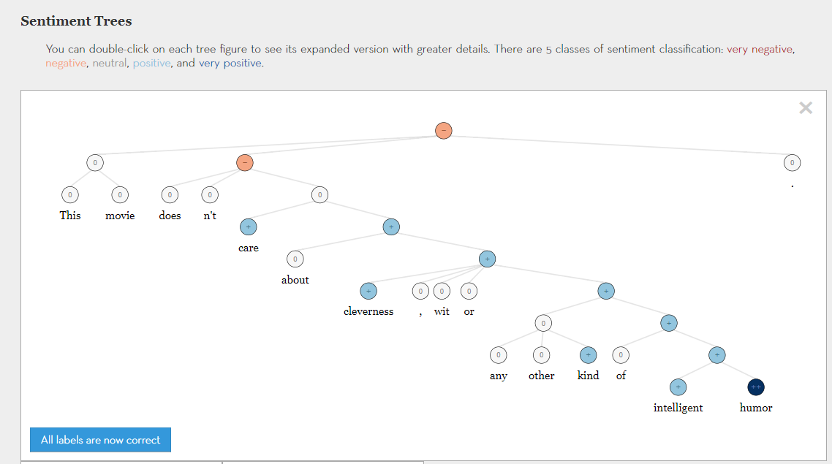
AI Natural Language Processing – Demo from Stanford University
http://nlp.stanford.edu:8080/corenlp/process
(deals with parts of speech, names, dependencies in languages)
http://nlp.stanford.edu:8080/sentiment/rntnDemo.html
(sentiment analysis using recursive deep neural network)

Slide 21
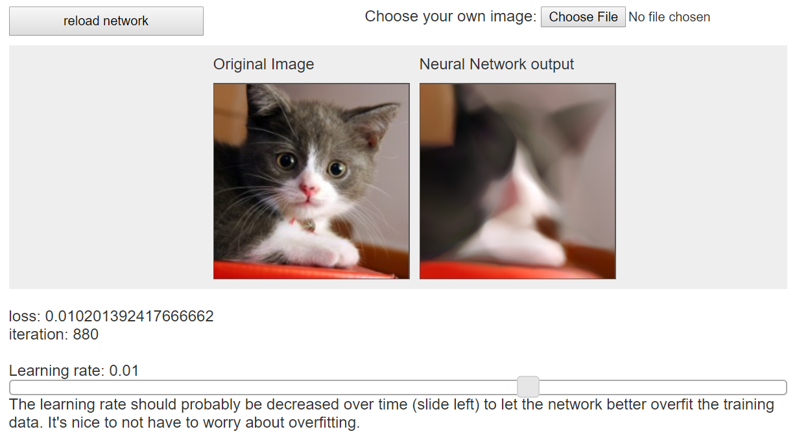
AI Image Processing – Demo from Stanford University
https://cs.stanford.edu/people/karpathy/convnetjs/demo/image_regression.html
(Image painting using convolutional neural network)

Slide 22
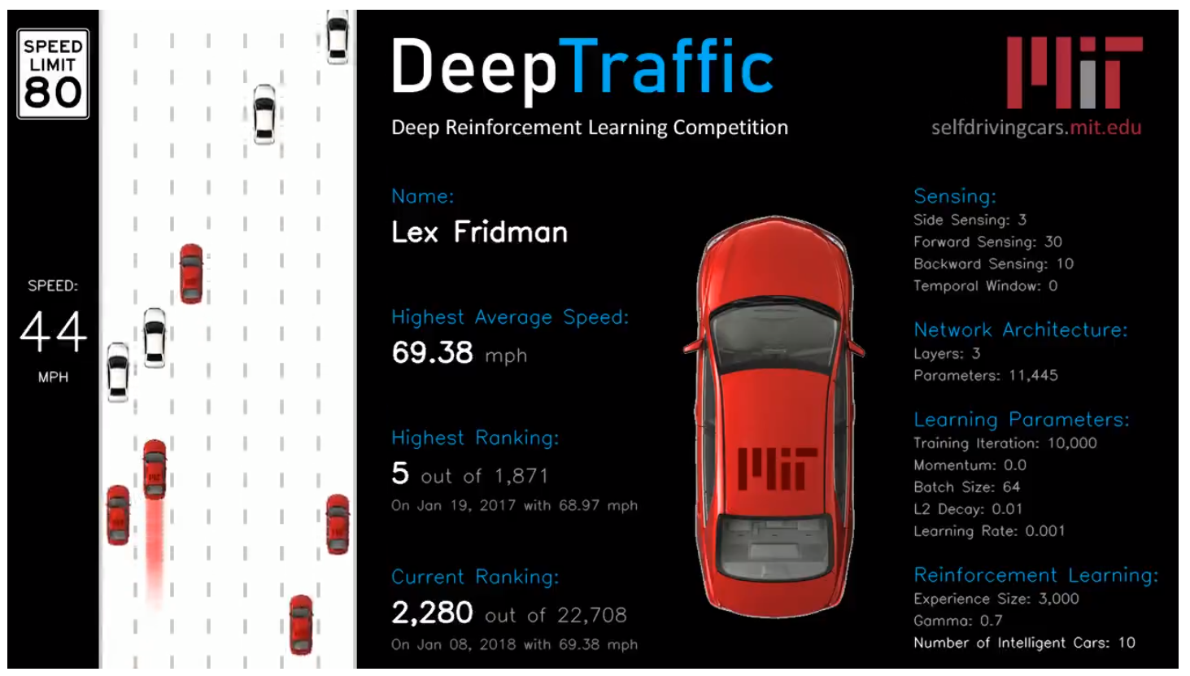
AI Self-Driving Cars – Simulation Demo from MIT University
https://selfdrivingcars.mit.edu/deeptraffic/
(Deep Traffic - Deep Learning for Self-Driving Cars using Deep Reinforcement Learning

